Slide 1
MULTI-FREQUENCY OBSERVATIONS USING MULTIFEED SYSTEMS
ALESSANDRO ORFEI, INAF-ORA (IRA)
(Istituto Nazionale di Astrofisica-Osservatorio di Radioastronomia)

Slide 2
NOTICE: PLEASE, TAKE NOTE !
ON 1st August 2015 A MAJOR CHANGE OCCURRED IN ITALIAN RADIOASTRONOMY
IRA (Istituto di Radioastronomia) NO MORE EXISTS.
IT HAS BEEN MERGED WITH OAC (Osservatorio di Cagliari) TO BECOME
ORA (Radioastronomy Observatory)
AIM: UNIFY RESEARCH AND FACILITIES FOR ITALIAN RADIOASTRONOMY IN ONE SINGLE STRUCTURE.
SINCE 1st January 2016 DIRECTOR of ORA WILL BE STEVEN TINGAY (now at Murchison Widefield Array, Australia)

Slide 3
NEW DEMANDS FOR VLBI OBSERVATIONS
NEW GENERATION 3mm-VLBI OBSERVATIONS CALLS FOR THREE ASPECTS:
INCREASED CAPABILITIES, i.e.
STATE OF THE ART RECEIVERs,
WIDEBAND
LONGER INTEGRATION TIME at 3 mm
MULTI-FREQUENCY (STATED AT 13, 7 and 3 mm BANDS)
SIMULTANEITY or at least NEAR SIMULTANEITY WITH FAST BAND SWITCHING
DIMENSIONS OF THE RECEIVER AS THOSE ALREADY USED AT THE ANTENNA
ADDITION OF TELESCOPES
REQUIREMENTS 1d, 1e and 2 ARE PROFITABLY FULFILLED BY USING MULTIFEED TECHNIQUE

Slide 4
OVERVIEW OF THIS TALK
IS A RECEIVING SYSTEM WITH 3 RECEIVER CHAINS (K, Q and W BAND) AT HAND TODAY? WITH WHICH PERFORMANCE?
COULD IT BE MADE SUCH THAT IT EASILY FITS IN ALMOST ANY (EVN) ANTENNA?
CHANCES TO OBSERVE NEAR SIMULTANEOUSLY OR SIMULTANEOUSLY WITH A
‘MINOR’ EFFORT OF R&D?
COULD THE TRI-FEED RECEIVER BE MADE AT AN ‘AFFORDABLE’ COST?

Slide 5
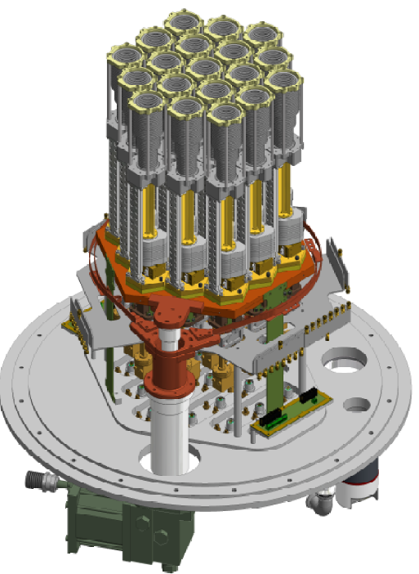
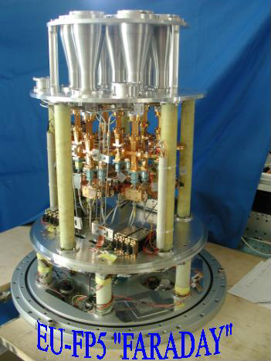
TRI-FEED CRYOSTAT DIMENSIONS
K
W
Q
EU-FP7- ’APRICOT’
EU ??
570mm
630
400
7-feed
18-26 GHz
Cryostat
(includes cal injection)
19-feed
33-50 GHz
Cryostat
(includes 1° conv, cal injection and LO distribution)
Tri-feed
22/44/86 GHz
Cryostat
(includes 1° conv, cal injection and LO distribution)
700
850
650

Slide 6
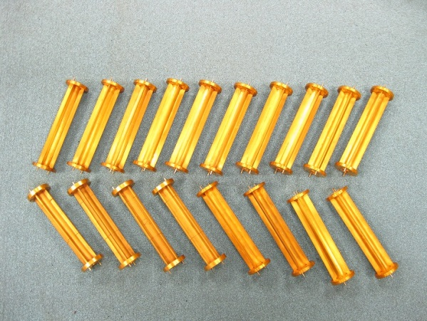
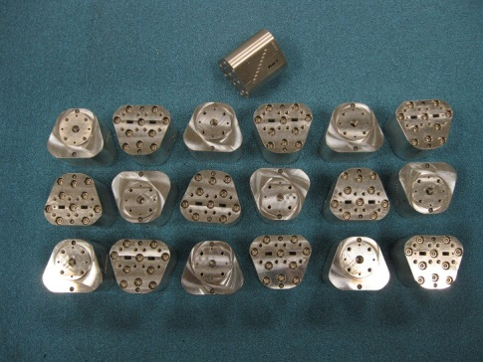
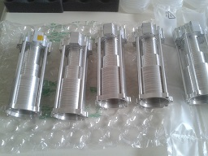
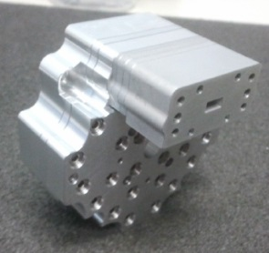
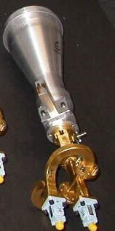
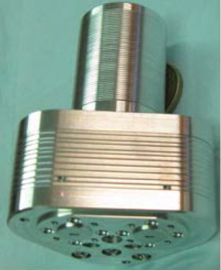
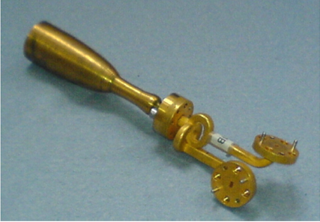
TRI-FEED TECHNOLOGY: EXAMPLES
33-50 GHz cal injector
33-50 GHz OMTs (INAF-OAA design)
33-50 GHz horn
(INAF-OAA design)
33-50 GHz polarizers
7 mm BAND
13 mm BAND
3 mm BAND
84-116GHz horn+omt
Courtesy G. Pisano, B. Maffei
67-116 GHz horn+omt
(INAF-OAA,Firenze,
Courtesy R. Nesti)
Talk at this Workshop
Option: reply as 7mm band (see Pisano’s talk) or other solutions
18-26 GHz horn to omt chain
(INAF-OAA design)
3mm band polarizer

Slide 7
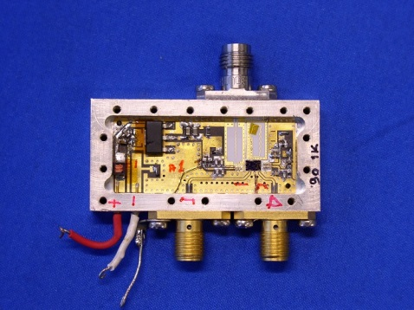
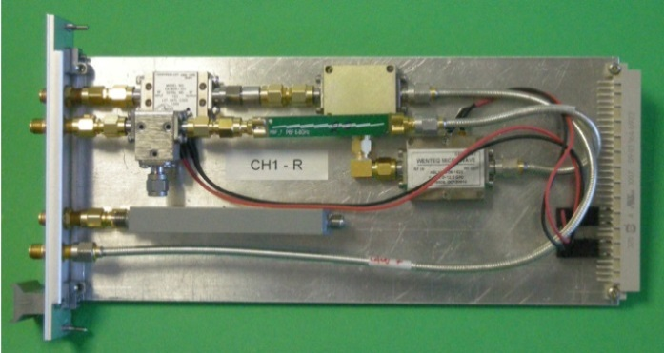
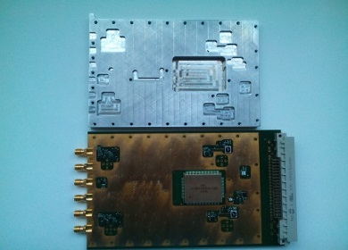
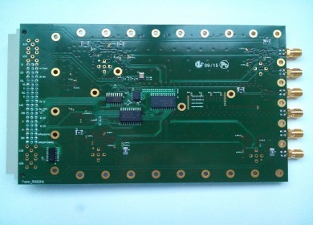
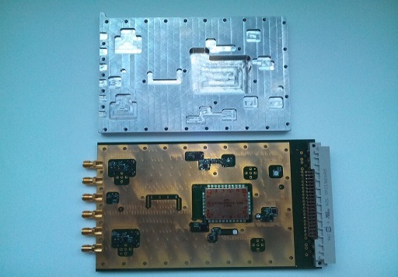
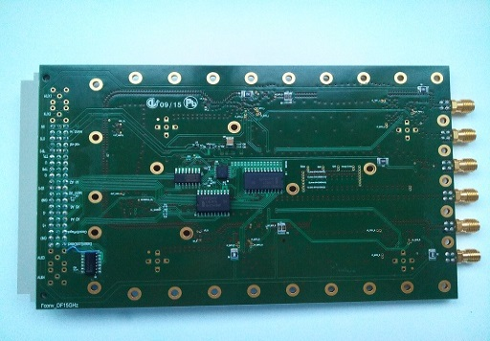
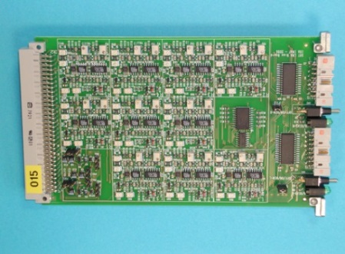
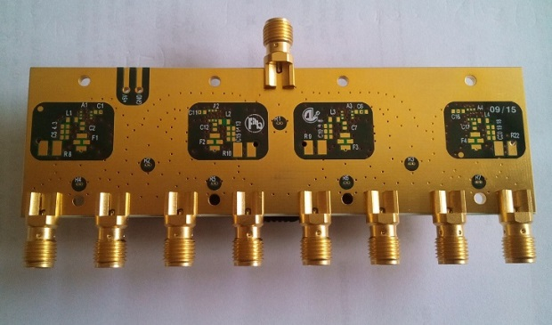
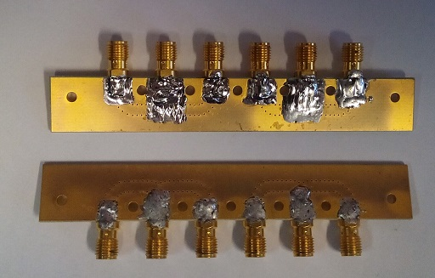
TRI-FEED ELECTRONICS: EXAMPLES
Q-CONV
K-CONV
W-CONV
75-110 GHz 1° conv. as K band technology
33-50 GHz to 1-18 GHz (Q band 1° conversion)
18-26 GHz to 6-8 GHz (K band 1° conversion)
Rear
Front
Rear
(Q and K band 2° conversion and W band 3° conversion)
Front
(W band 2° conversion)
Cryo LNAs Power Supply Board
LO Distributors (up to 18 GHz)

Slide 8
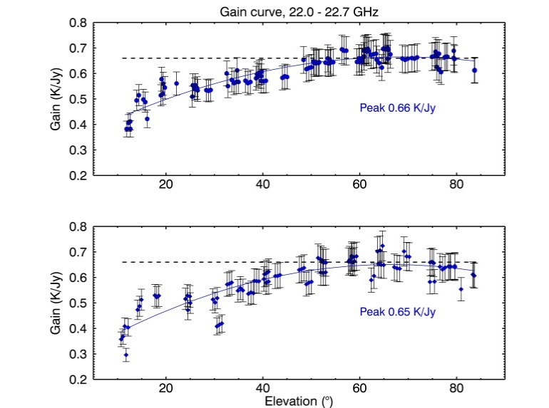
ITALIAN TELESCOPES AVAILABILITY
SRT: active surface equipped; overall surface accuracy today = 300μm; future ≈ 180μm
-K band available,
-Q band under construction
-W band under implementation
Noto: active surface equipped; overall surface accuracy today ≈ 400μm; possible ≈ 200 μm
K and Q bands available
Medicina: no active surface; max operating frequency = 26GHz

Slide 9
TRI-FEED ASSEMBLING AND PERFORMANCE ESTIMATION
400mm
 | SRT |  |  | Noto (or Med upgraded)
 | 13mm | 7mm | 3.5mm | 13mm | 7mm | 3.5mm
Band (GHz) | 18-26 | 33-50 | 75-110 | 18-26 | 33-50 | 75-110
Tsys (K, zenith) | 70⁰ | 60 | 110⁴ | 65⁵ | 60 | 110⁴
G (K/Jy) | 0.66¹ | 0.5² | 0.19³ | 0.15⁶ | 0.14⁶ | 0.1⁶
SEFD (Jy) | 106 | 120 | 579 | 433 | 428 | 1100
Crosspol, D-term | ≈ 2%
NOTES 0: Measured (τ₀=0.06) 1: Measured 2: with today surface accuracy = 300μm; 0.60K/Jy with surface accuracy = 180μm 3: with today surface accuracy = 300μm 0.44K/Jy with surface accuracy = 180μm 4: with τ₀=0.2 5: Measured, new 18-26GHz receiver at Medicina (τ₀=0.13) 6: with upgraded subreflector surface, rms ≤ 50μm
Tri-feed
22/44/86 GHz
Cryostat
(includes 1° conv, cal injection and LO distribution)
650
Conversions, Control, LNA’s power supply, LOs distributor,
……
600
480

Slide 10
TRI-FEED NEAR SIMULTANEITY IN ITALY: READY
primary mirror
Tri-feed beams parameter
 | SRT | Med/Noto
 | (arcmin) | (arcmin)
FWHM 13 mm | 0.85 | 1.8
FWHM 7 mm | 0.48 | 0.9
FWHM 3.5 mm | 0.25 | 0.5
W-K Beam separation | 1.32 | 2
W-Q Beam separation | 0.72 | 1.1
W to Q bands horn distance | 31 mm
W to K bands horn distance | 58 mm
tilting subreflector
K
W
beams
Q
Tri-feed beams switching
 | SRT | Med/Noto
 | (s) | (s)
W to K switching time | 1 | 0.5
W to Q switching time

Slide 11
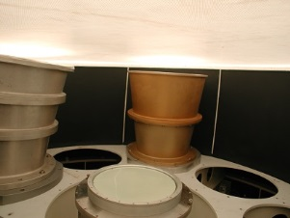
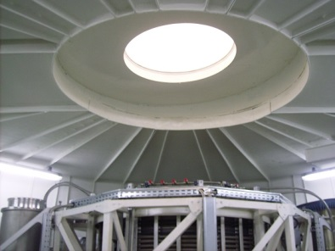
R&D FOR SIMULTANEOUS TRI-FEED
THE ADDED-ON DEVICE DIMENSIONS MUST BE COMPATIBLE
WITH THE ROOM AVAILABLE BETWEEN TOP OF THE CRYOSTAT
AND THE VERTEX OF THE PRIMARY MIRROR AND ALL AROUND
THE TRI-FEED.
AN EXAMPLE at Medicina/Noto secondary focus….
ADDED-ON DEVICE
400
Tri-feed
22/44/86 GHz
Cryostat (incl. Noise cal and 1° conversion)
Goretex cover of the
secondary focus cabin
650
7 GHz
5 GHz
<600mm
Tri-feed
Conversions, Control, LNA’s power supply, LOs distributor,
……
….and SRT
600
Incoming radiation
Tri-feed
480
Rotating drum

Slide 12
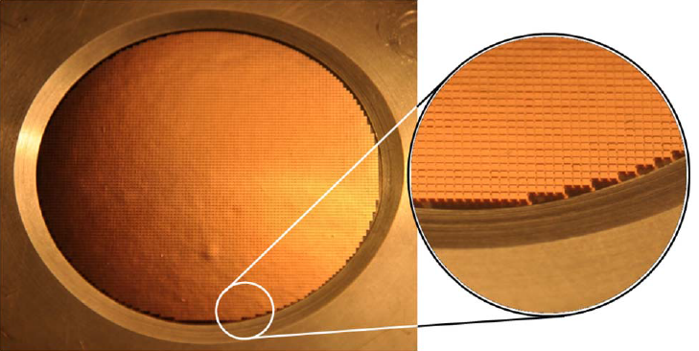
TRI-FEED SIMULTANEITY: A PROPOSAL for R&D
primary mirror
subreflector
FSBT
K
W
beams
Q
f
Frequency Selective Beam Tilter
(Talk at this workshop: G. Pisano)
d
f= 160mm
D= 54mm
d= 2.3mm
loss= 2.5%
D
Critical parameters: D, d, f, loss
75-110 GHz mesh lens with multiple grids
(Pisano et al., Applied Optics 2013)

Slide 13
COST ESTIMATION OF THE COMPLETE TRI-FEED
 | Note: for each telescope | Cost of materials
Q.ty | Component | (k€)
1 | FSBT | 30
3 | Feeds | 7
3+3 | Polarizers+Omts | 32
3 | Noise Cal Injectors | 12
6 | Cryo LNAs | 90
3 | LNAs Power Supply Boards | 15
10 | Frequency converters (incl. LOs distributor) | 185
3 | NoiseCal system | 25
1 | Cryogenics | 110
 | Cables, connectors,..... | 35
 | Total | 540
red: specific design for each telescope

Slide 14
THANK YOU !

